Slide 1
Lecture 5

Slide 2
F_{out}
F_{in}
A_{in}
A_{out}

Slide 3
Question 123.5.1
P=0
If the barometer shown here were used on Mars, would h be larger or smaller
Larger
Smaller
h
P_{o}

Slide 4

Question 123.5.2
The pressure at point A in this monometer is ________ the pressure at point B
higher than
lower than
the same as
Pipe with a higher pressure, P_{pipe} that we wish to measure
Δh
A
B
P_{A}
P_{B}

Slide 5
P_{t} = 0
P_{t} = P_{atm}
h
A
B

Slide 6
Pressure Measurement: Barometer
P_{t} = 0
In many pressure measurements, the idea is to make the pressure due to a column of fluid equal to the pressure to be measured
For the barometer,
We solve for the height of the liquid (usually Hg)
Would a water be practical to use for a barometer?
P_{t} = P_{atm}
h
A
B

Slide 7
Pressure Measurement: Barometer
P_{t} = 0
In many pressure measurements, the idea is to make the pressure due to a column of fluid equal to the pressure to be measured
For the barometer,
We solve for the height of the liquid.
For water this would be
P_{t} = P_{atm}
h
A
B

Slide 8
Pipe with a higher pressure, P_{pipe} that we wish to measure
Δh
A
B
P_{A}
P_{B}

Slide 10
Question 123.5.3
Take a beach ball sized parcel of water. What happens if we replace the parcel with the beach ball?
The ball will rise because it is less dense than the water
The ball will rise because the buoyant force will be larger for the beach ball
The ball will rise because it’s surface area will be different than the parcel of water
B
F_{g}

Slide 11
Question 123.5.3.5
We say that there is a buoyant force acting on the beach ball. What is the buoyant force?
It is the net force on the beach ball
It is the net force due to the water pressure acting on the beach ball
It is a force that makes things float at the surface
50

Slide 12
Buoyant Forces
Remember from
a stationary parcel of water there is a force that balances the weight of the parcel
Forces that act in the x-direction (sideways) balance each other
-P_{o}Aĵ
P_{m}A x
-P_{m}A x
j
PAĵ
i
Mg

Slide 13
Buoyant Forces
Now take a beach ball sized parcel of water
There is a force due to gravity and a force due to the pressure
What happens if we replace the parcel with the beach ball?
B
W

Slide 14
Archimedes’ Principle
The magnitude of the buoyant force always equals the weight of the fluid displaced by the object
For a cube
F_{t}=-P_{o}Aĵ
We know the force for a cube shaped parcel of water
B
h
h
Where M is the mass of the parcel of water
Mg
F_{b}=PAĵ
W
By replacing the cube of water with a cube of another material, we have not changed the forces acting on the cube

Slide 15
Case1: Totally Submerged Object
The magnitude of the buoyant force is
Think Archimedes: The weight of the fluid displaced by the object. So we have the volume of the object as part of our equation
If the object has mass
B
V_{object}
h
The net force is
F_{g}
The motion of an object submerged in a fluid is determined only by the densities of the object and the fluid

Slide 16
Buoyant Forces
Now take a beach ball sized parcel of water
There is a force due to gravity and a force due to the pressure
What happens if we replace the parcel with the beach ball?
B
W

Slide 17
Case 2: Partially Submerged Object
Assume and static equilibrium.
We define V_{fluid} as the volume of the fluid displaced by the object.
Then
B
V_{displaced}
W
The fraction of the volume of a floating object that is below the fluid surface is equal to the ratio of the density of the object to that of the fluid.

Slide 18
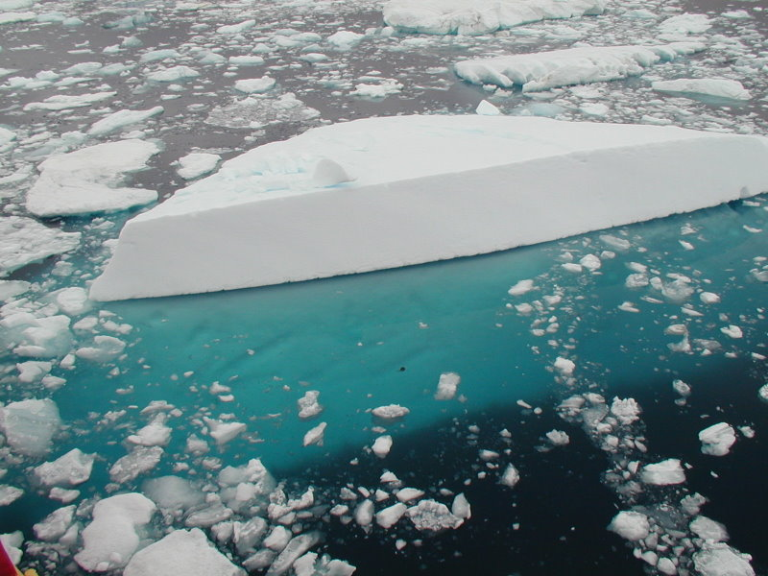
Iceberg with the submerged portion visible. From Geo Swan used under the licensed under the Creative Commons Attribution 2.0 Generic license.

Slide 19
Question 123.5.4
Two cups are filled to the same level with water. One of the two cups has ice cubes floating in it. When the ice cubes melt, in which cup is the level of the water higher?
h
A
B

Slide 20
Question 123.5.5
When a ball is floating on the surface of a pool, how does the force needed to push it under change with depth?
A
F
B
F
B
F_{g}
h
h
h
F
C
h

Slide 21
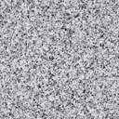
Question 123.5.6
I have somehow suspended a block of concrete in a fluid. I replace the concrete with a block of Styrofoam with equal volume. The buoyant force on the Styrofoam is
Larger than
smaller than
the same as
The buoyant force on the concrete.

Slide 22
